Slide 1
COLLEGE MANAGEMENT
Submitted to
Submitted by
Viresh Goyal 100186206579
Raju 100186206567
Bharat 100180626530
Anand 100180626529
Prof. Harpreet singh soch

Slide 2
INTRODUCTION OF PROJECT

Slide 3
STARTING OF PROJECT
AUTHENTICATION PHASE

Slide 4
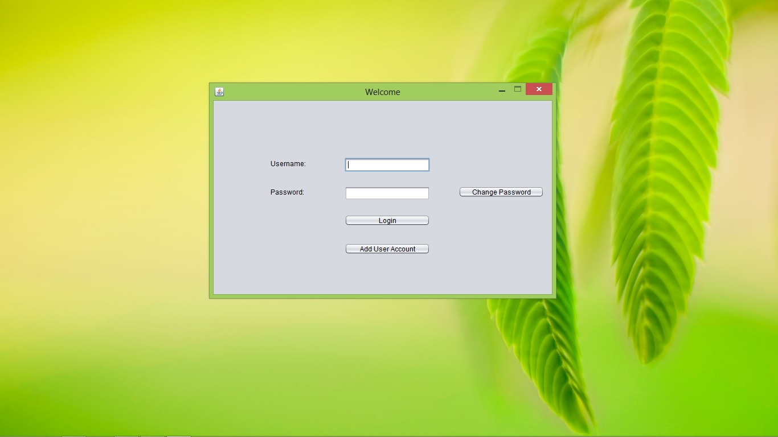

Slide 5
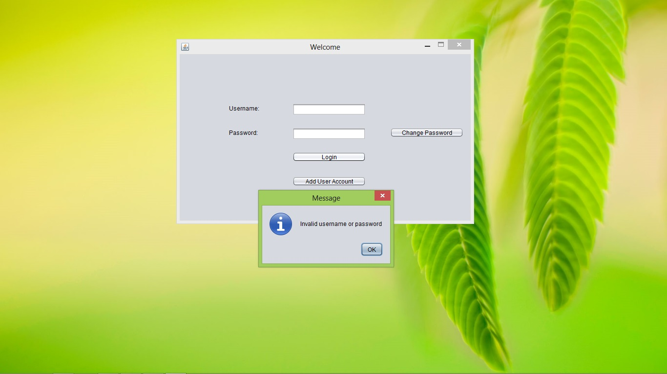

Slide 6


Slide 7
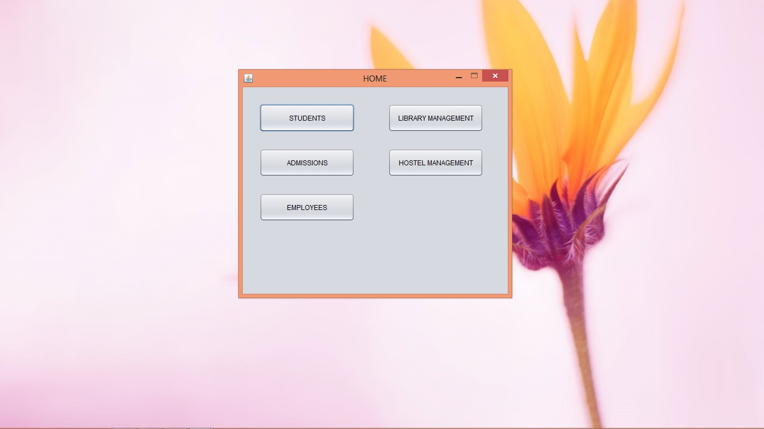

Slide 8
CHANGE PASSWORD
OF EXISTING USER

Slide 9
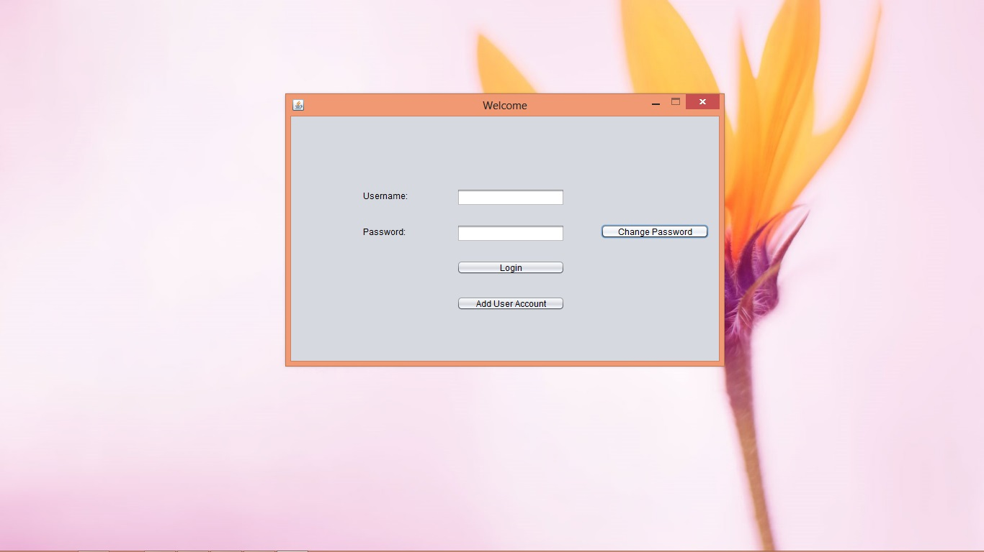

Slide 10
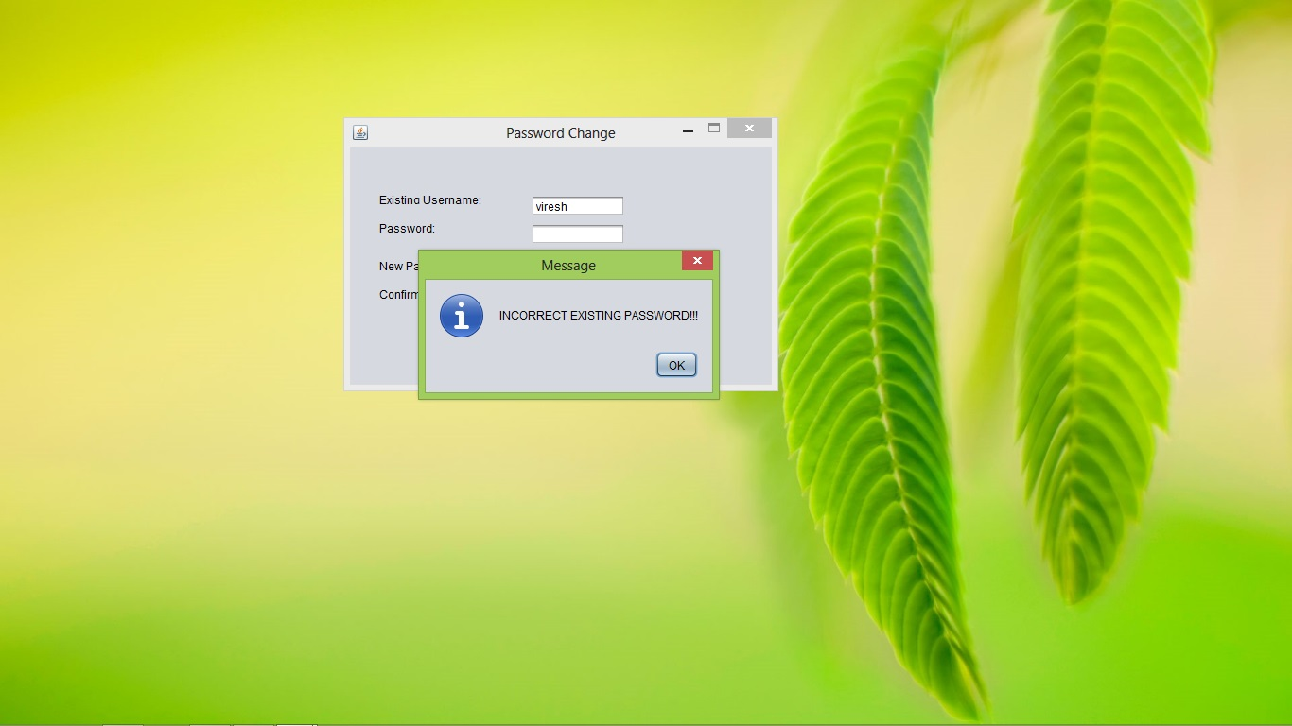

Slide 11
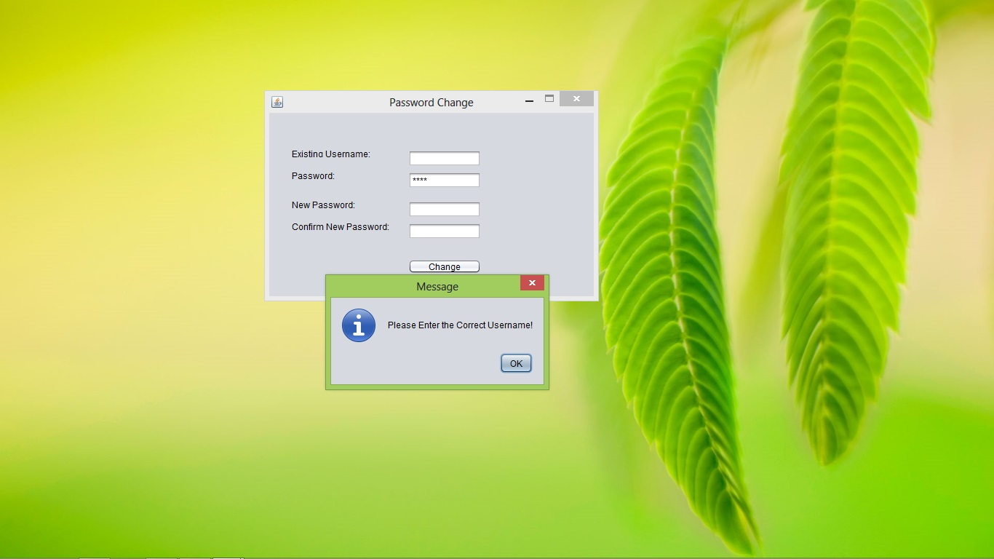

Slide 12
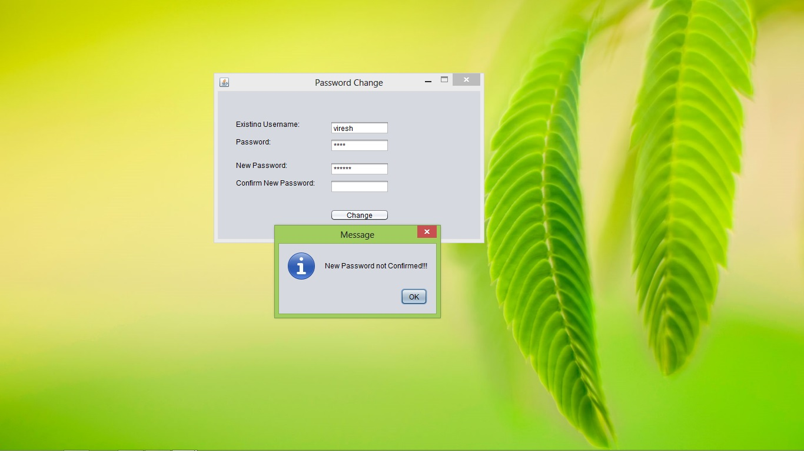

Slide 13
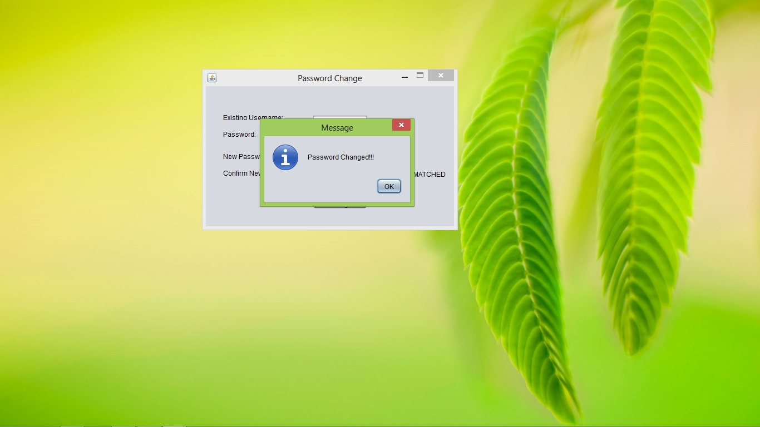

Slide 14
ADDING OF NEW USER

Slide 15


Slide 16
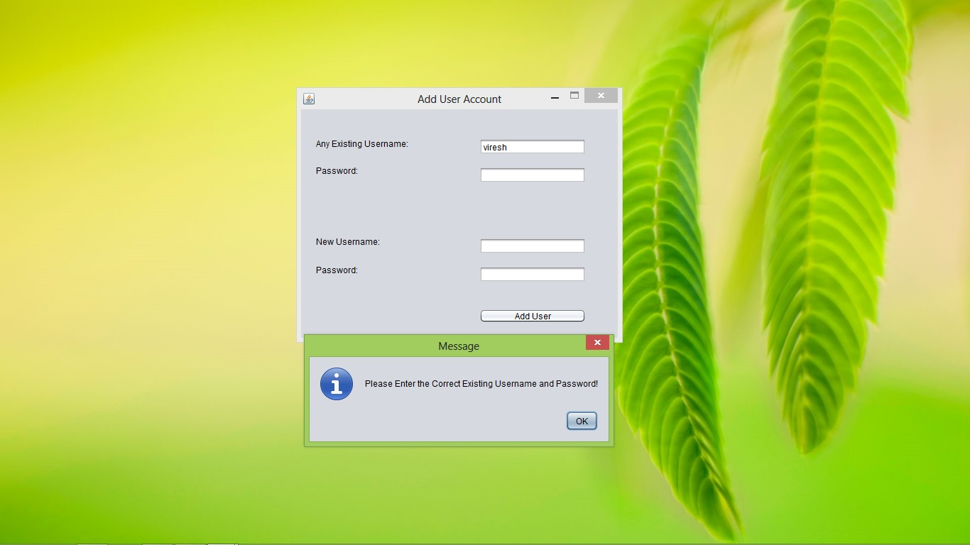

Slide 17
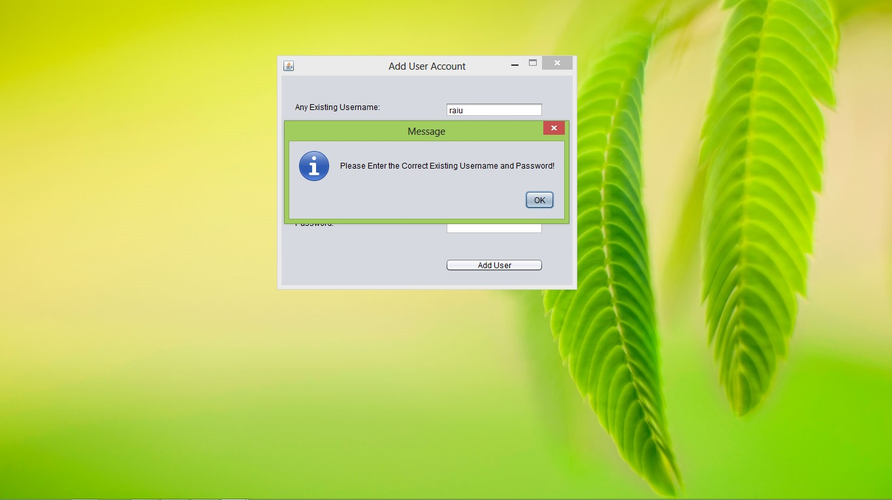

Slide 18
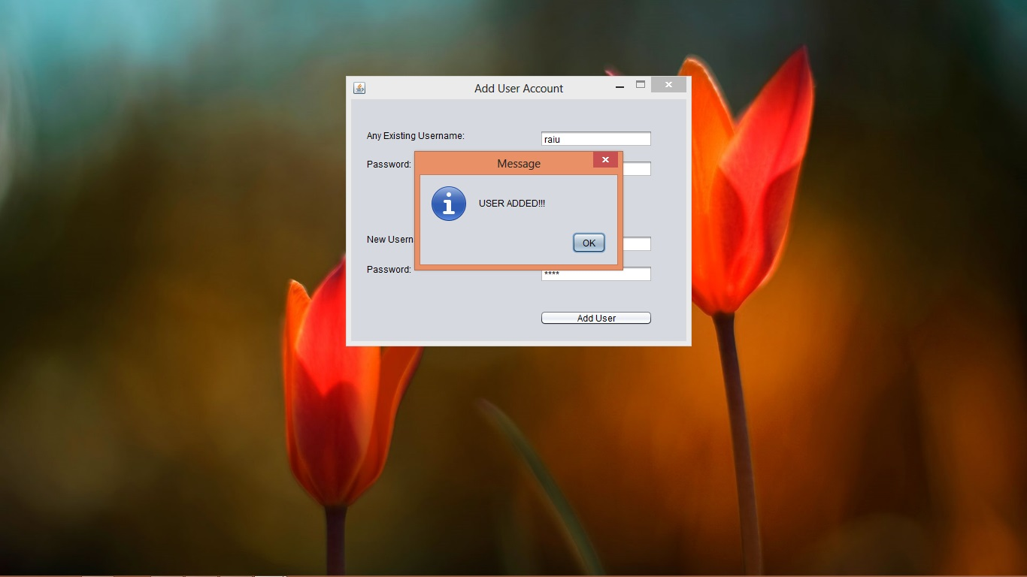

Slide 19
OPENING OF MAIN MODULES

Slide 20


Slide 21

STARTING WITH STUDENTS
ADD STUDENT DATA
VIEW STUDENT DATA
UPDATE STUDENT DATA
DELETE STUDENT DATA

Slide 23
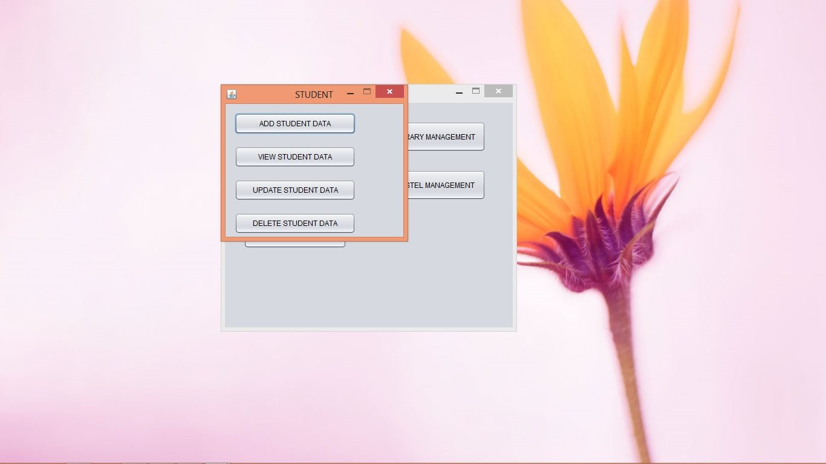

Slide 24
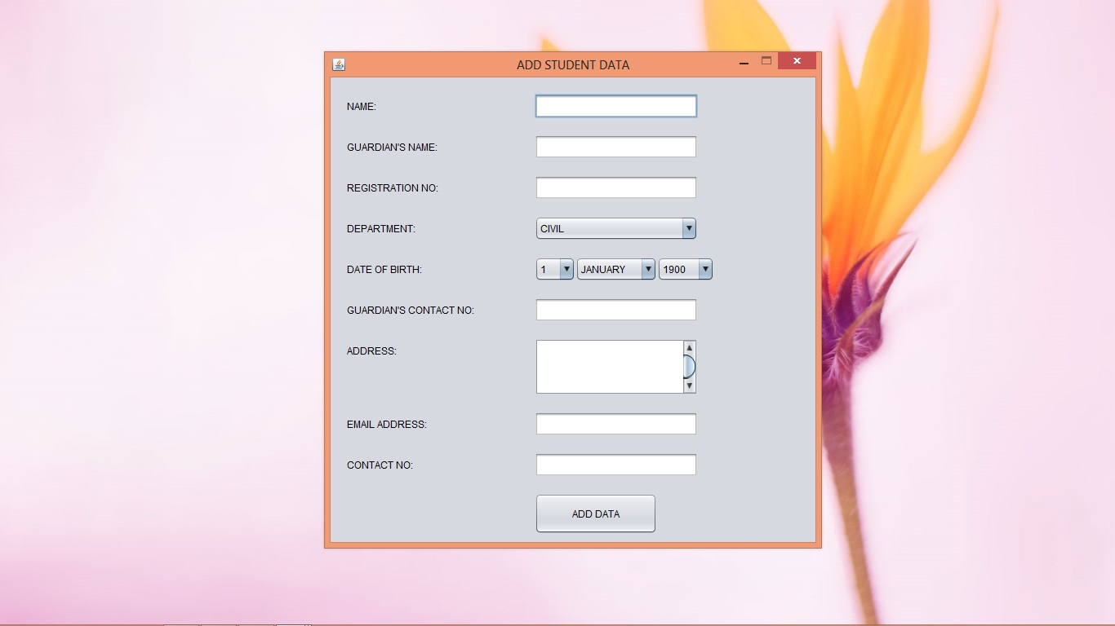

Slide 25
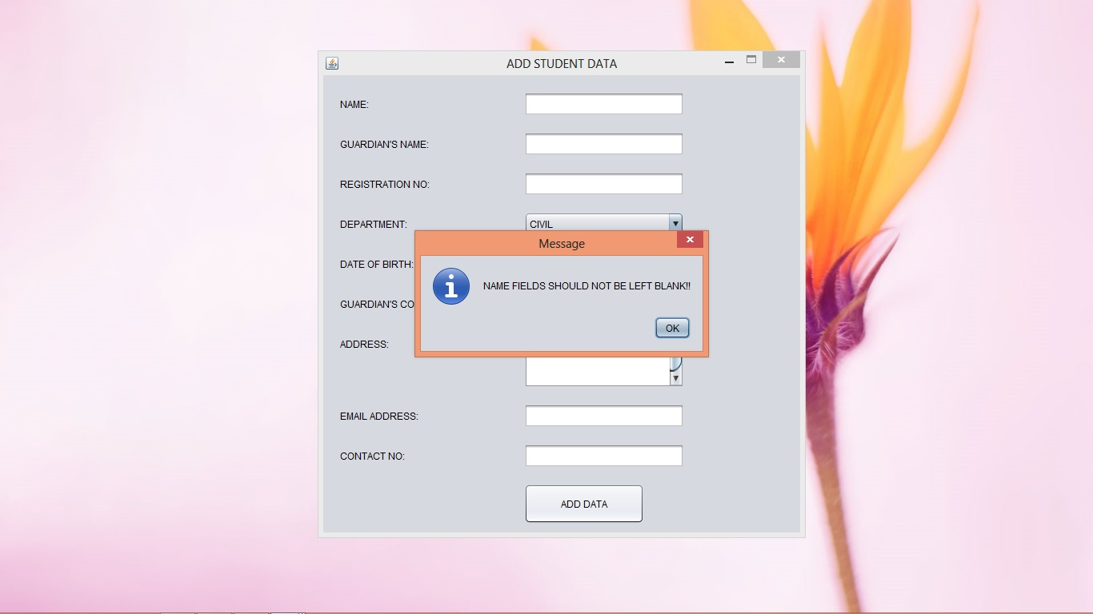

Slide 26
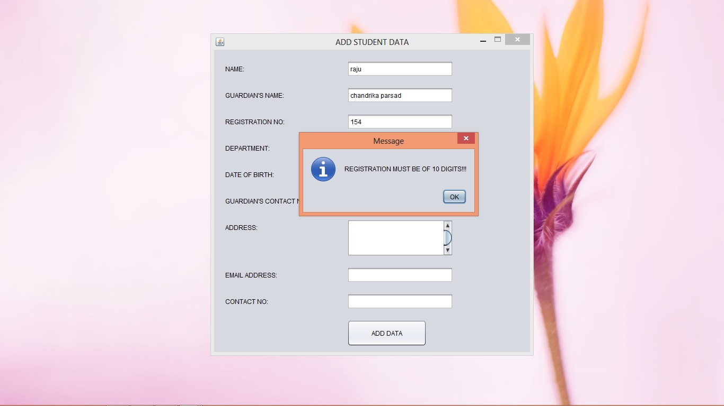

Slide 27


Slide 28
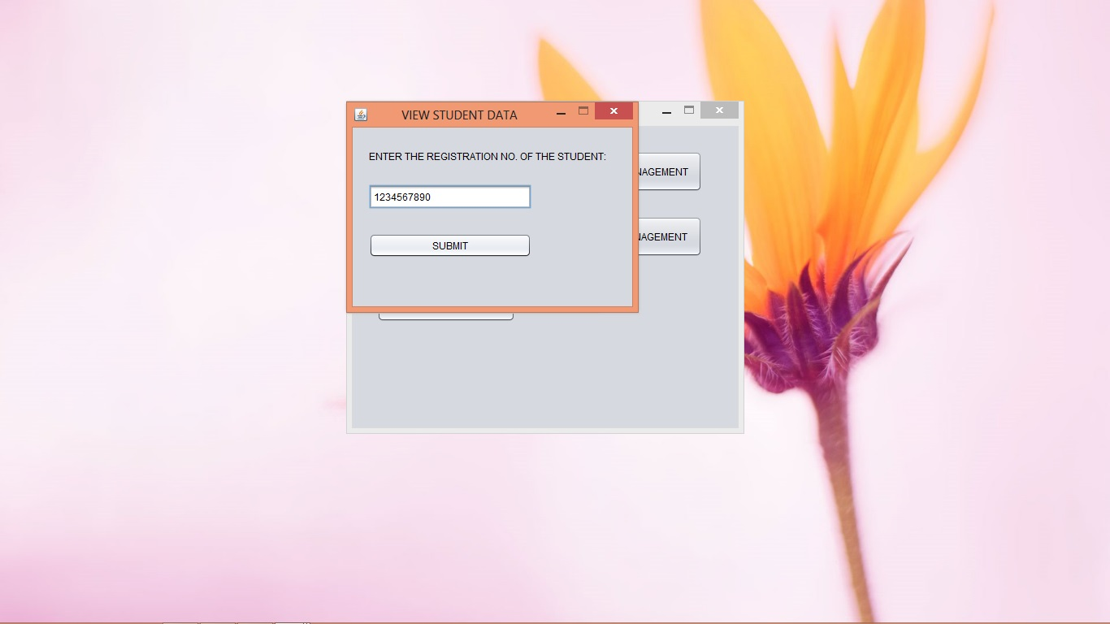

Slide 29
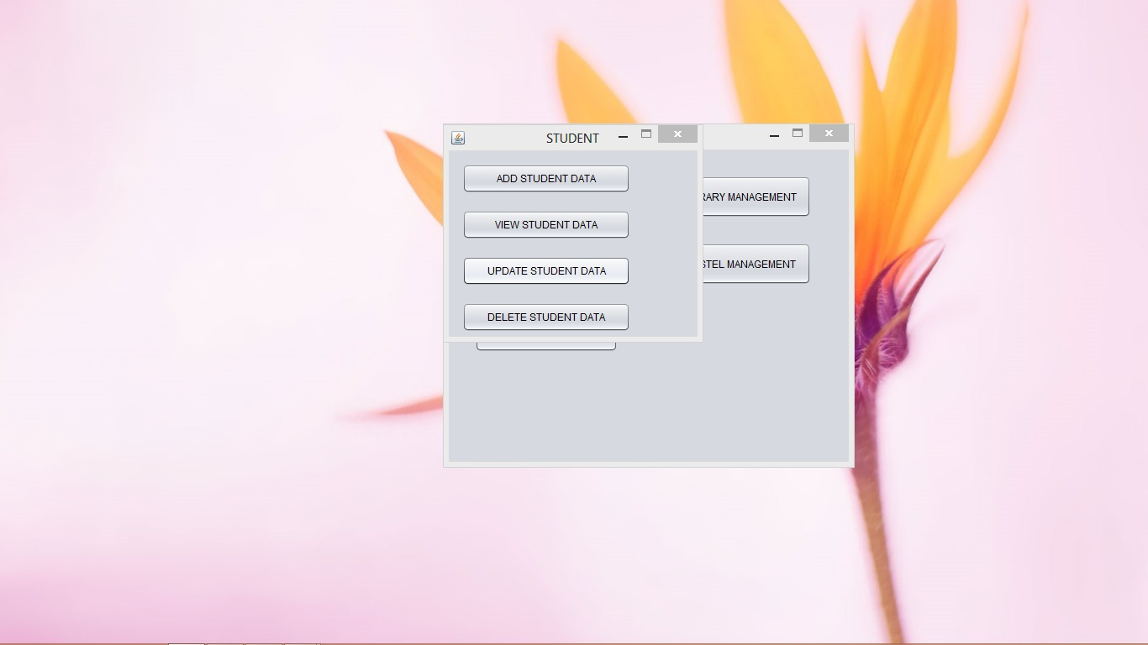

Slide 30
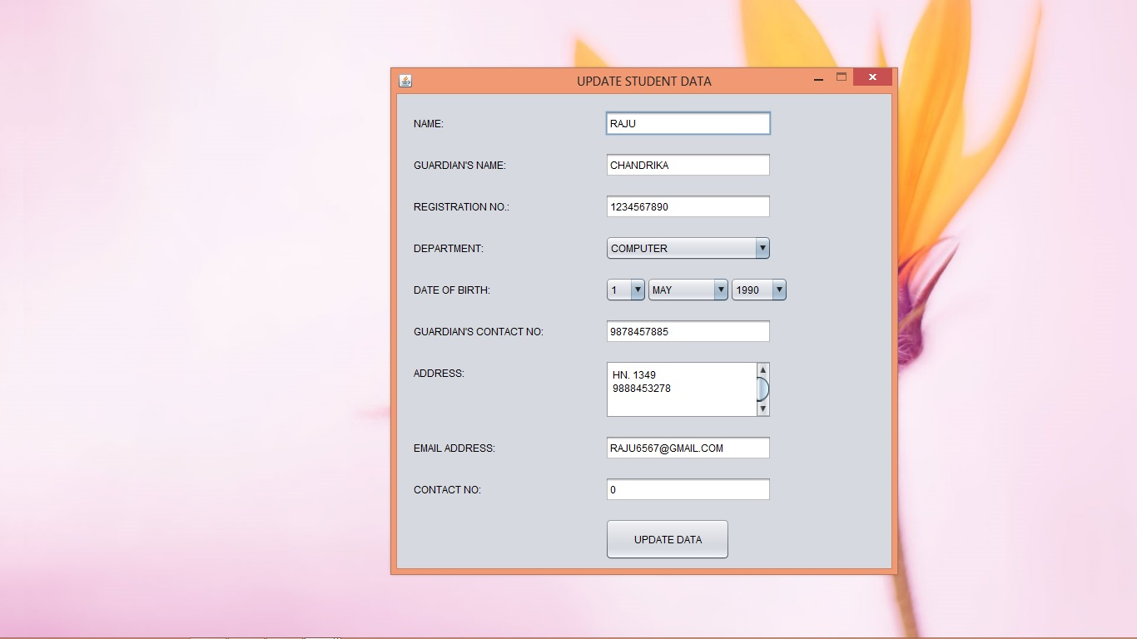

Slide 31
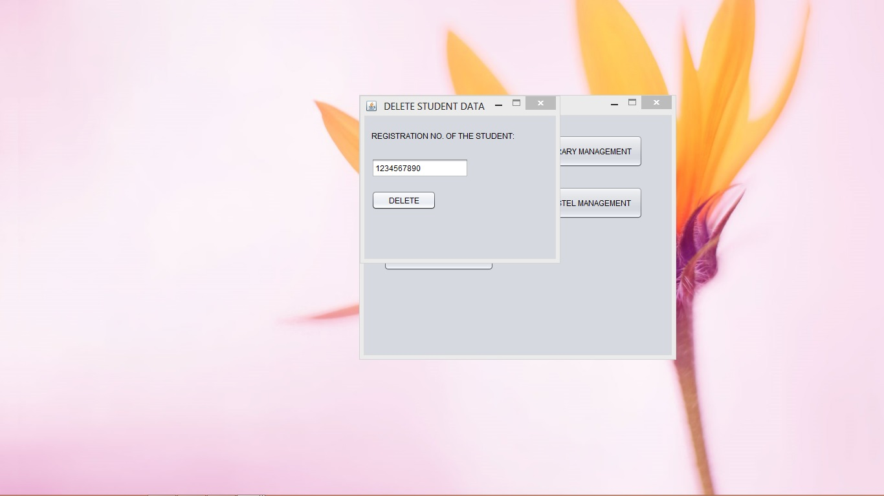

Slide 32
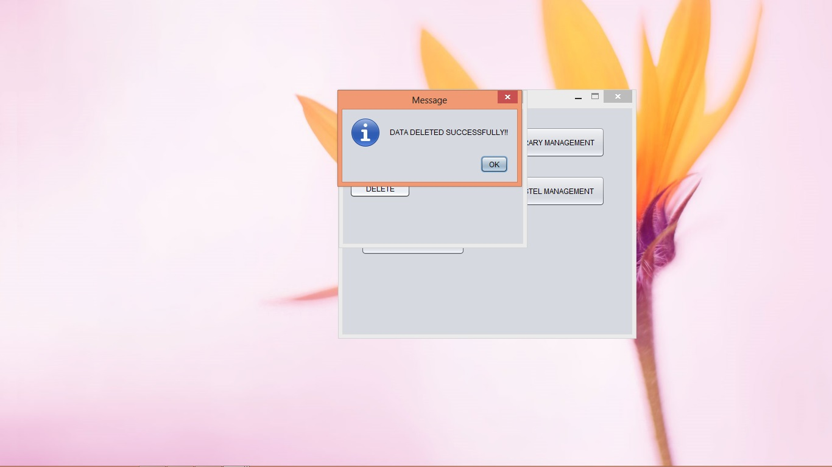

Slide 33
LIBRARY MANAGEMENT
SEARCH BOOKS
ISSUE BOOKS
ADD BOOKS
UNISSUE BOOKS
DELETE BOOKS

Slide 34
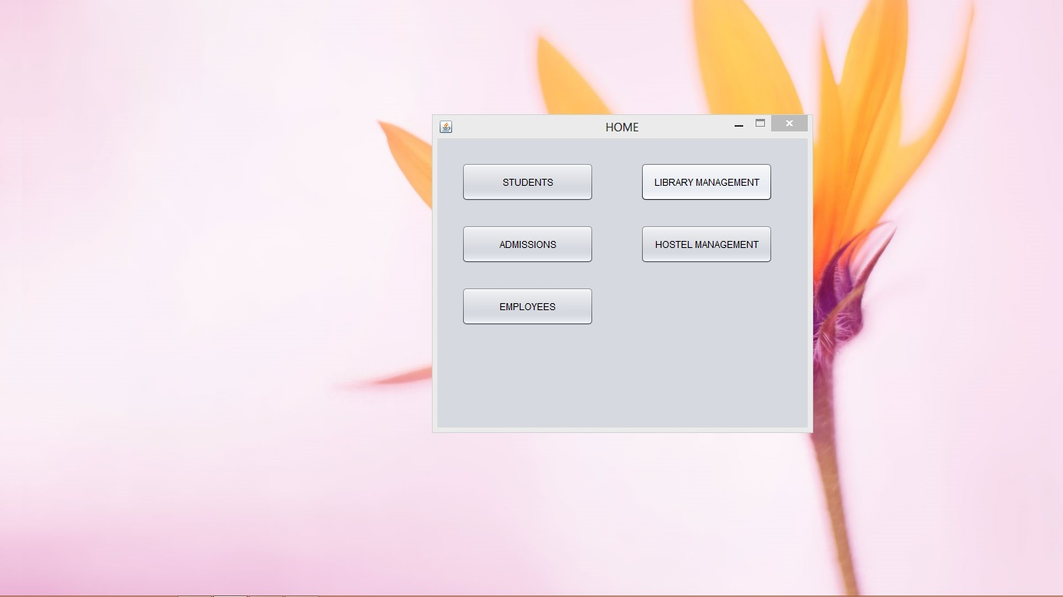

Slide 35
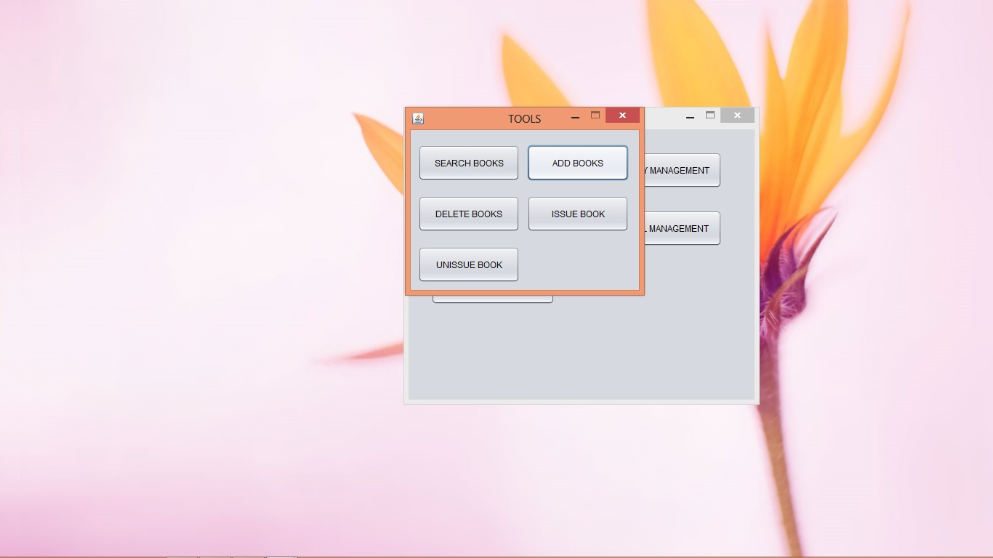

Slide 36
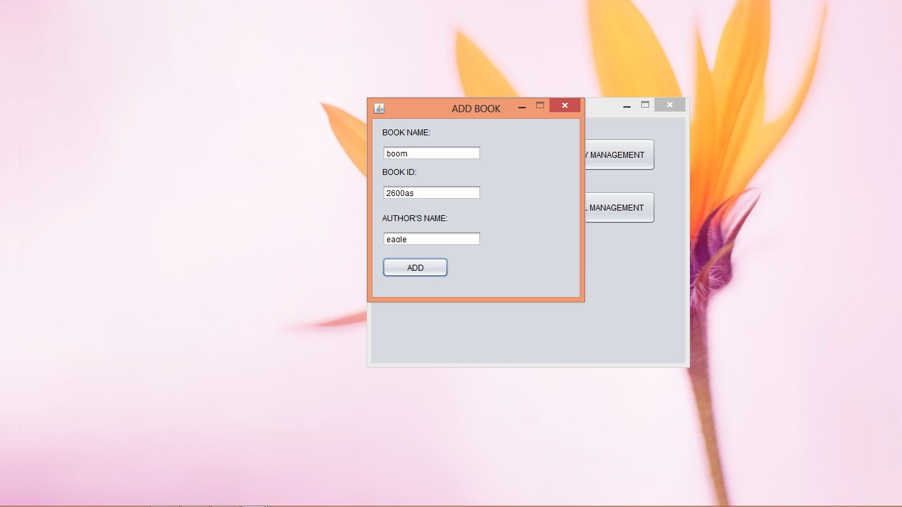

Slide 37
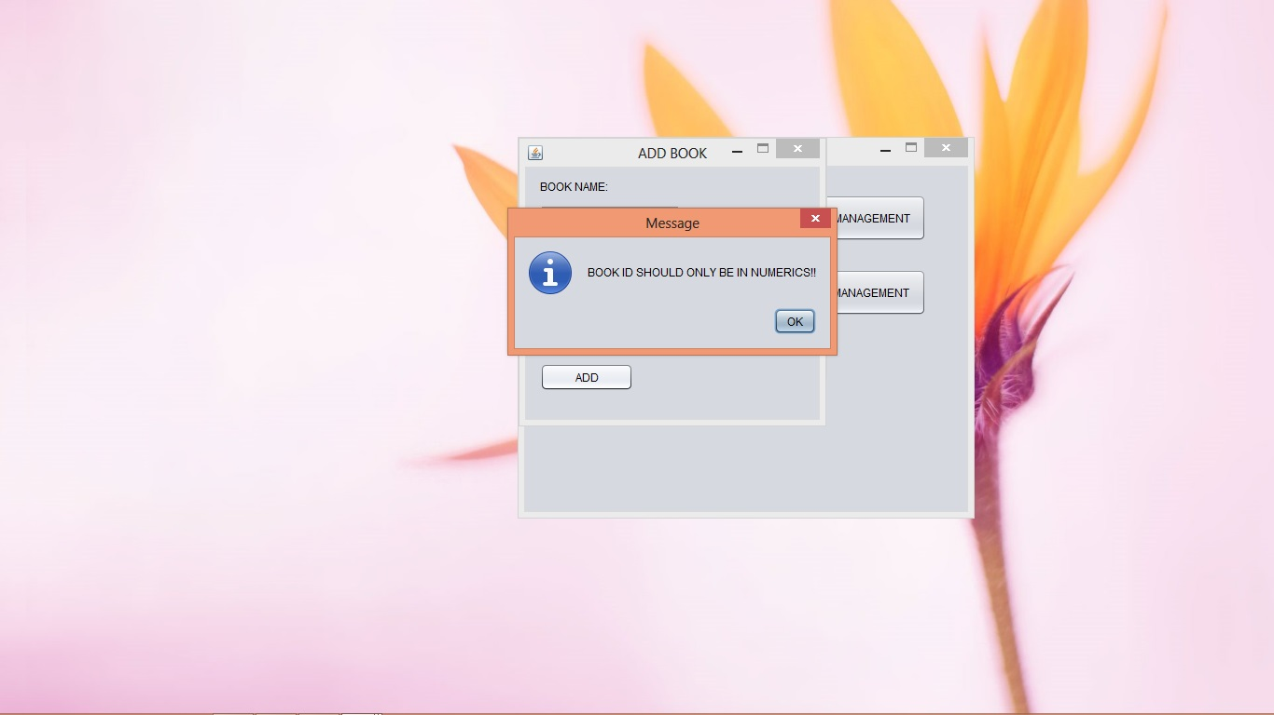

Slide 38
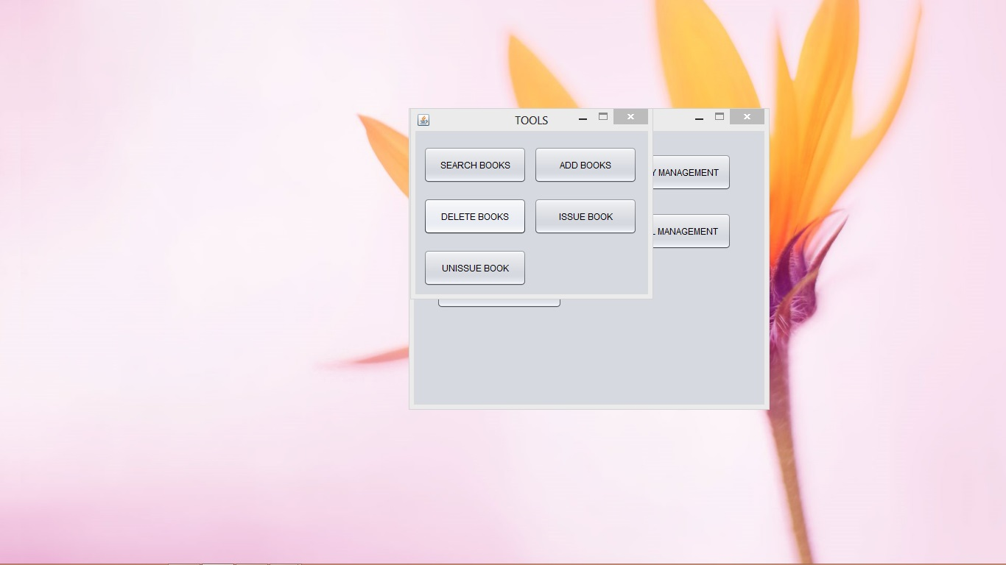

Slide 39
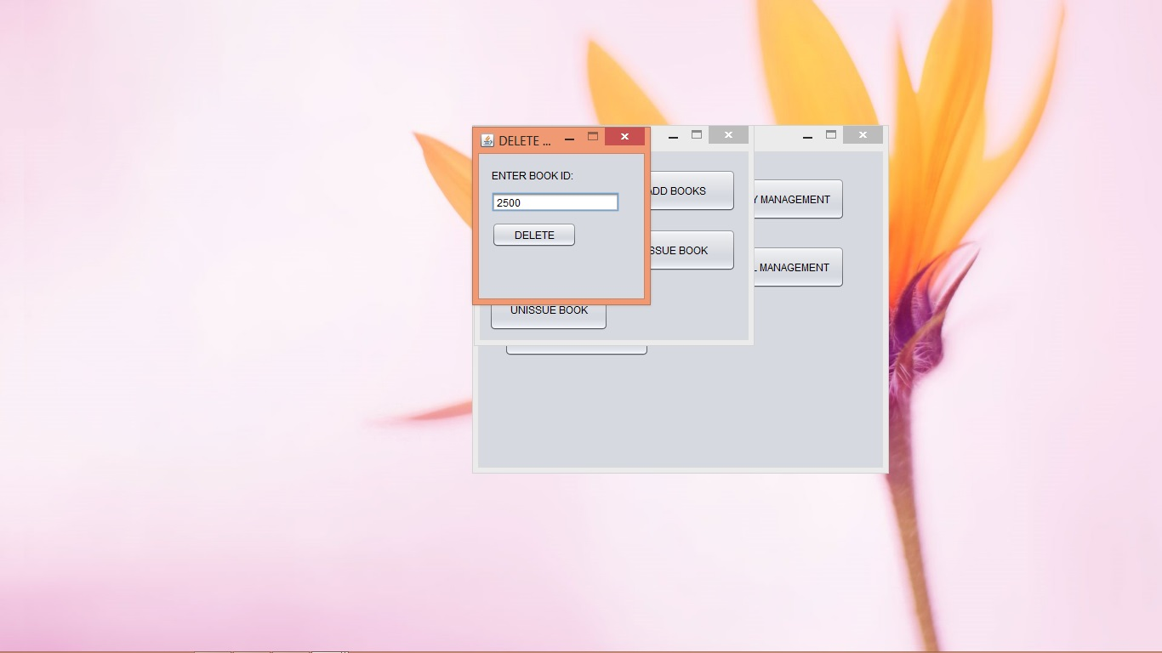

Slide 40
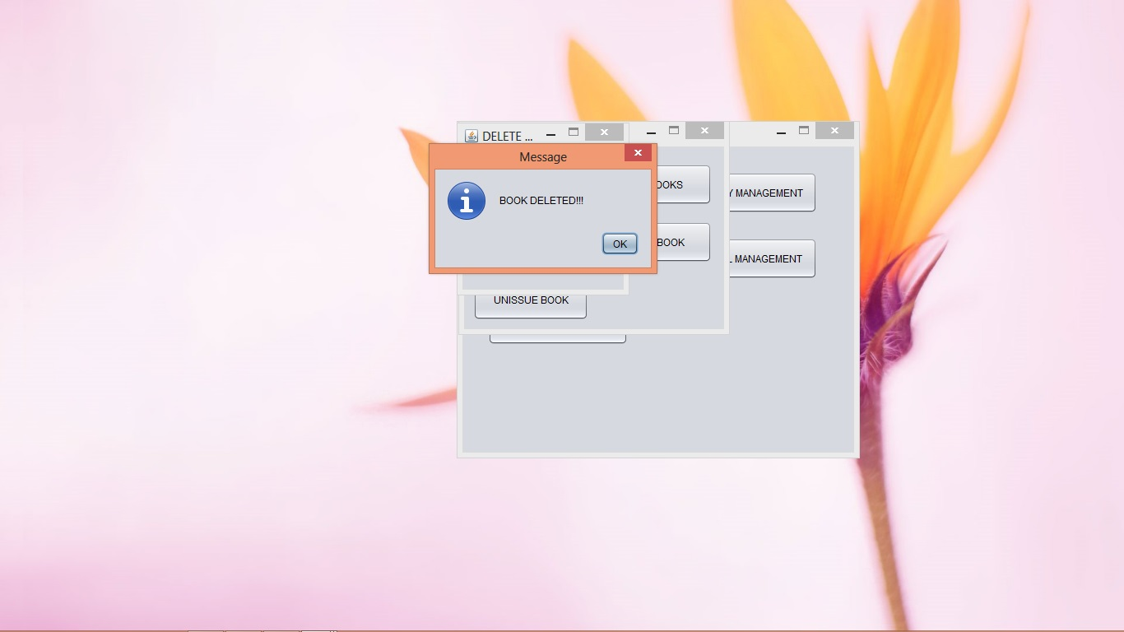

Slide 41


Slide 42
ADMISSION MODULE
ADD NEW ADMISSION
UPDATE STUDENT ADMISSION
DELETE STUDENT ADMISSION
REFRESH STUDENT LIST

Slide 43
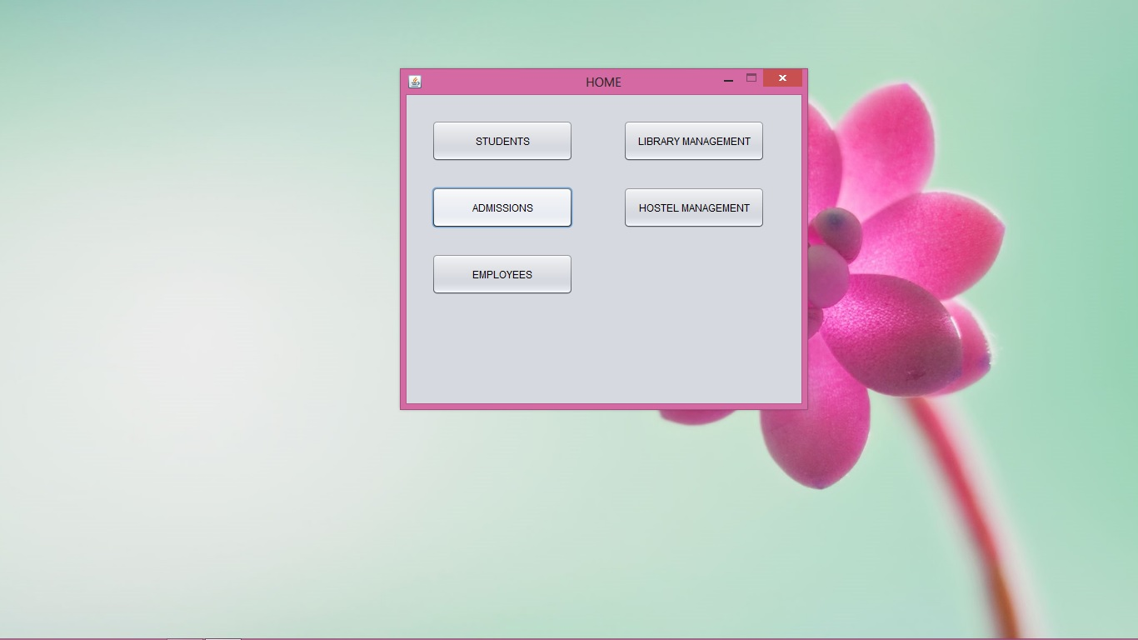

Slide 44
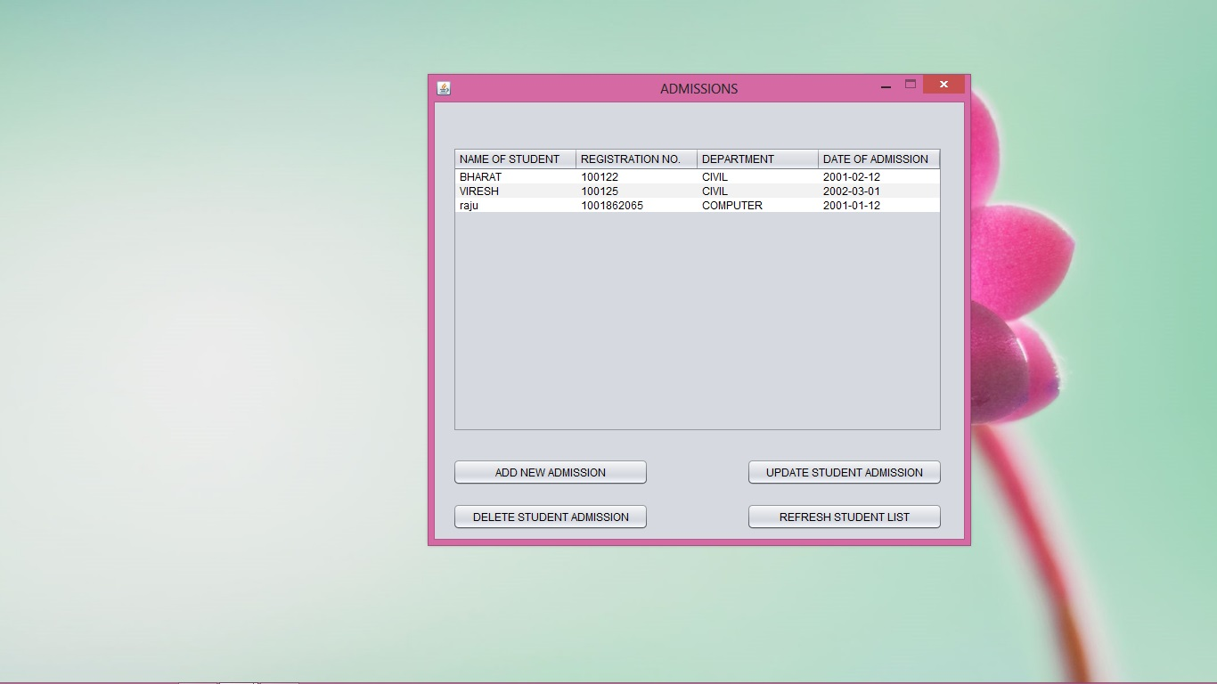

Slide 45
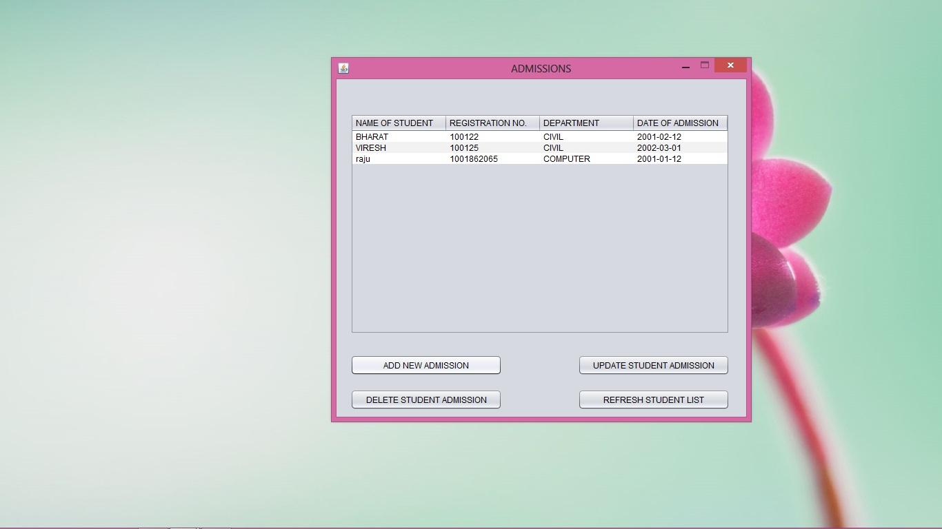

Slide 46
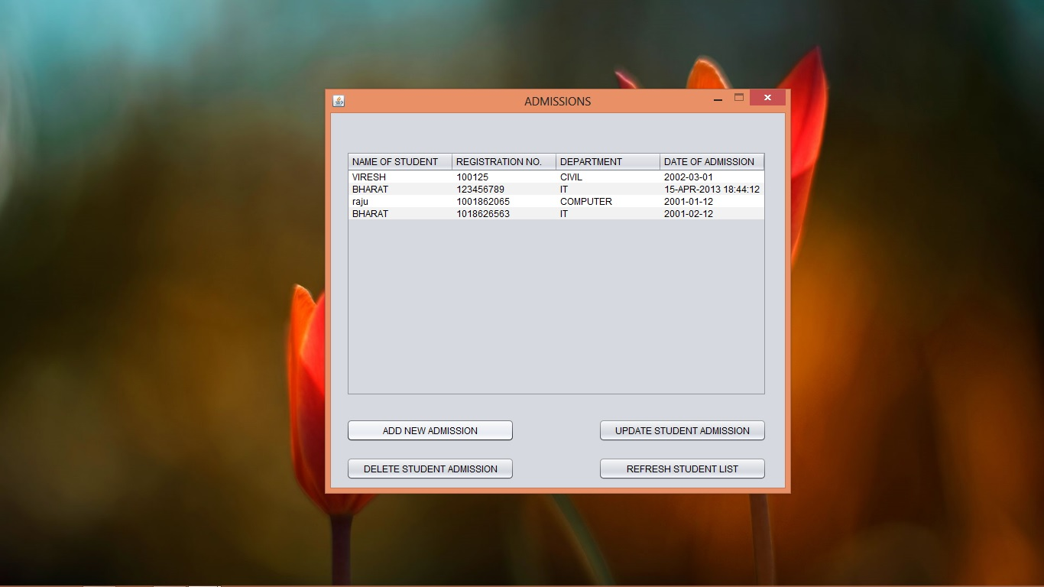

Slide 47


Slide 48
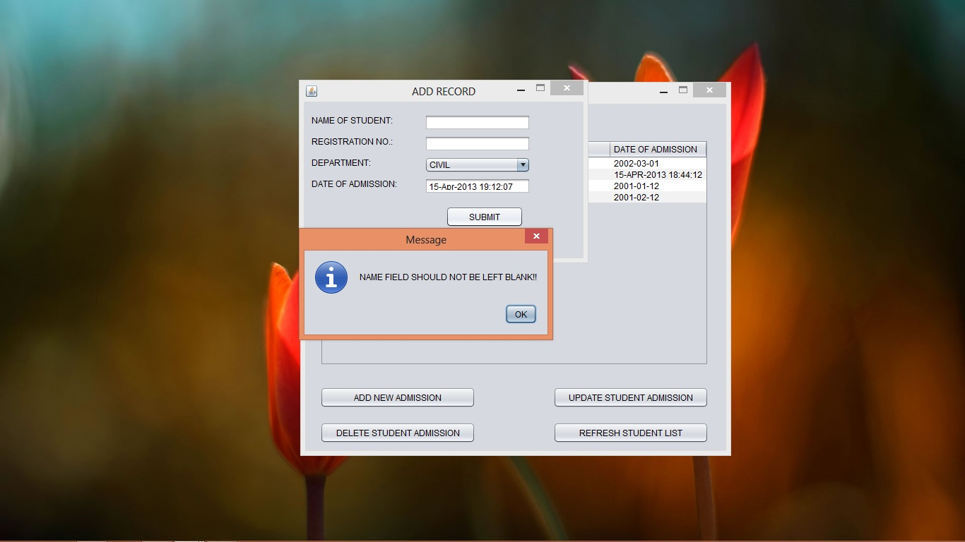

Slide 49
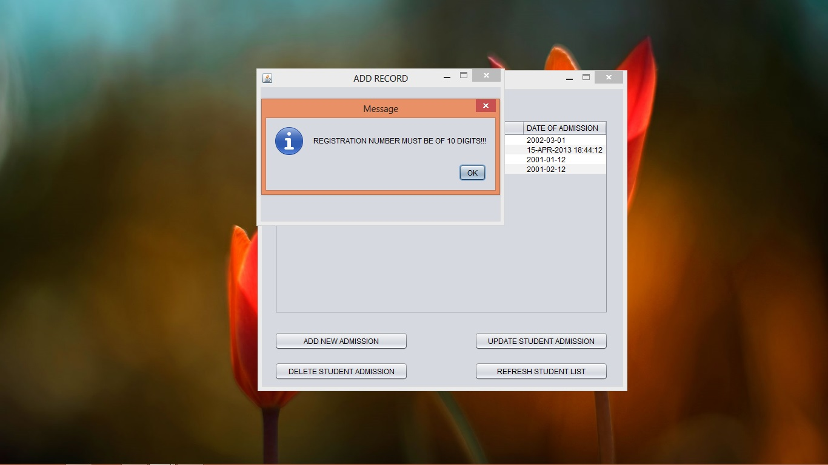

Slide 50
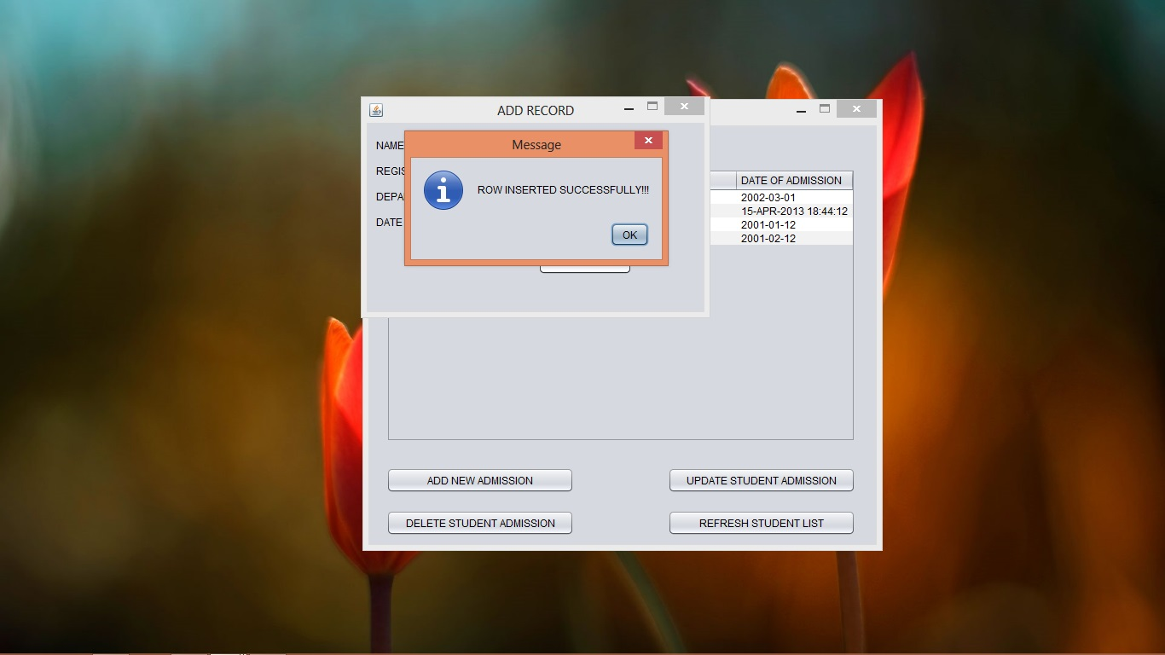

Slide 51
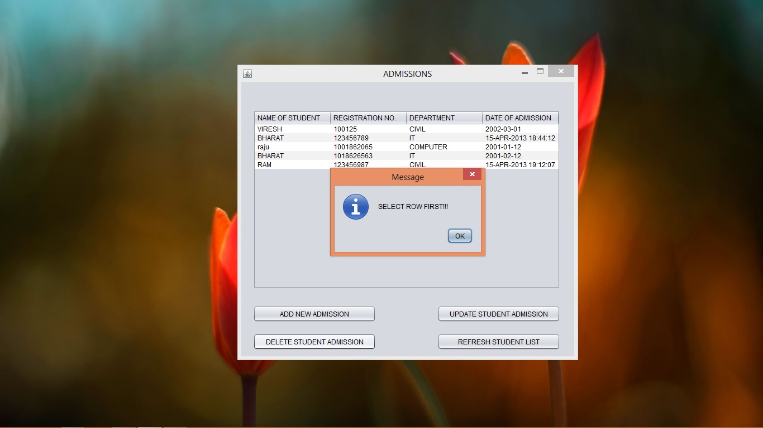

Slide 52
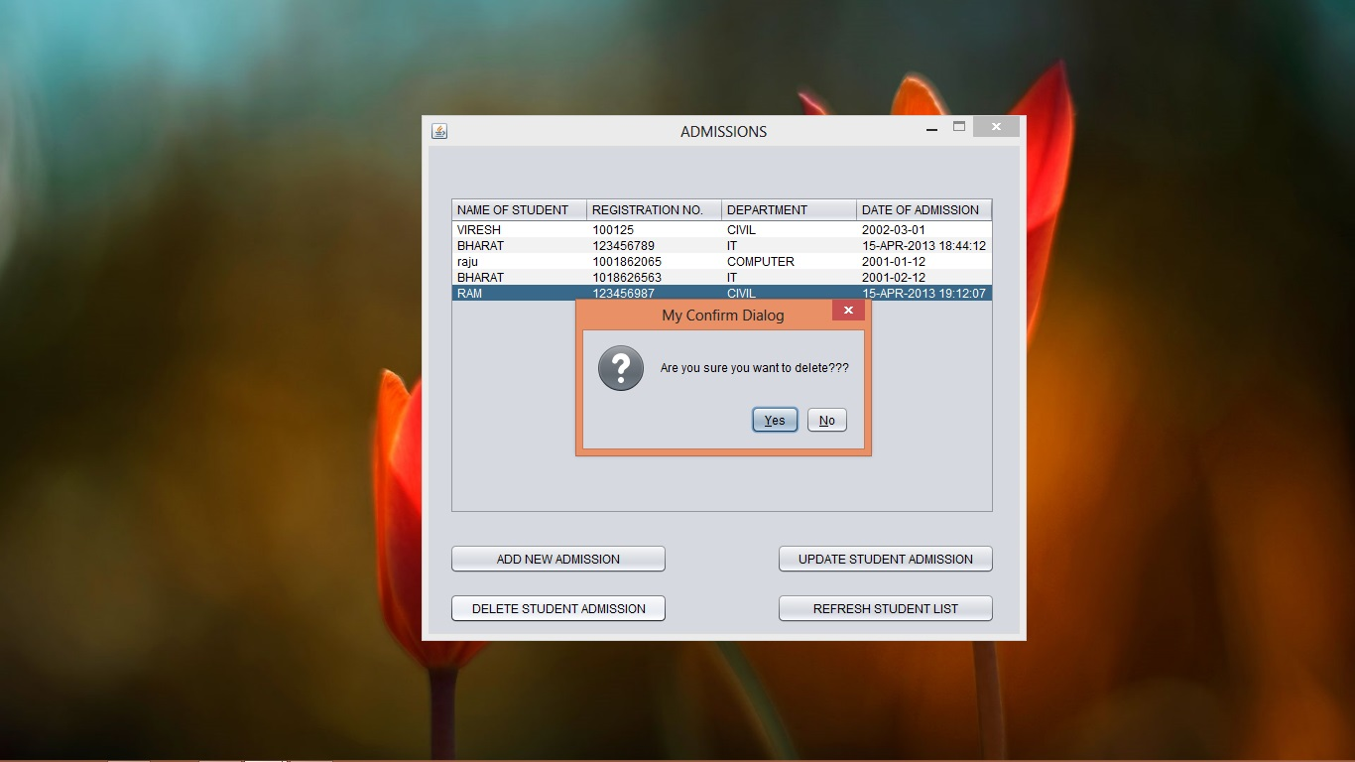

Slide 53
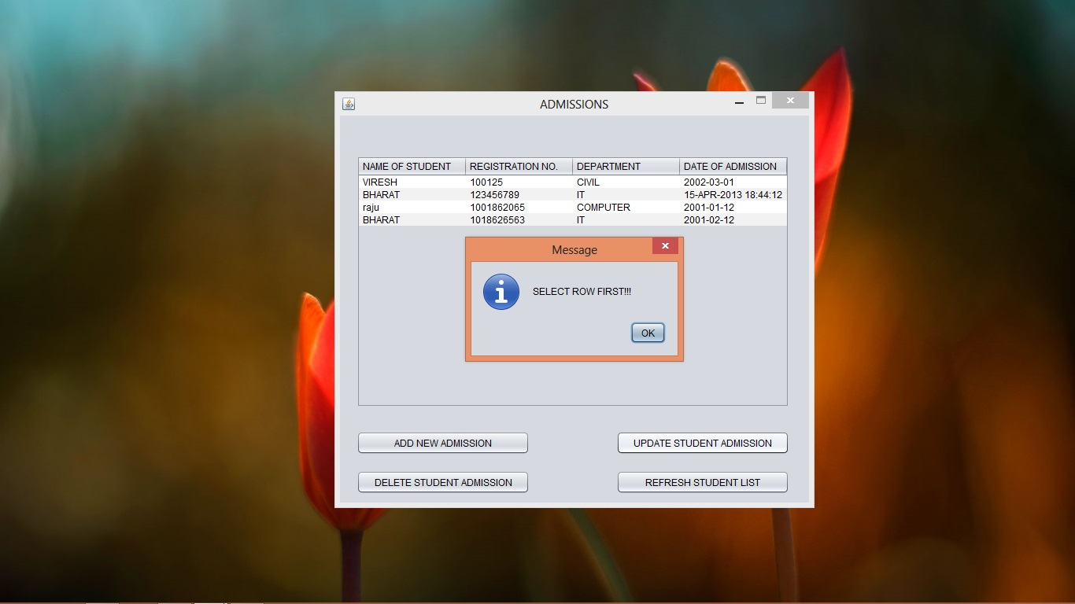

Slide 54
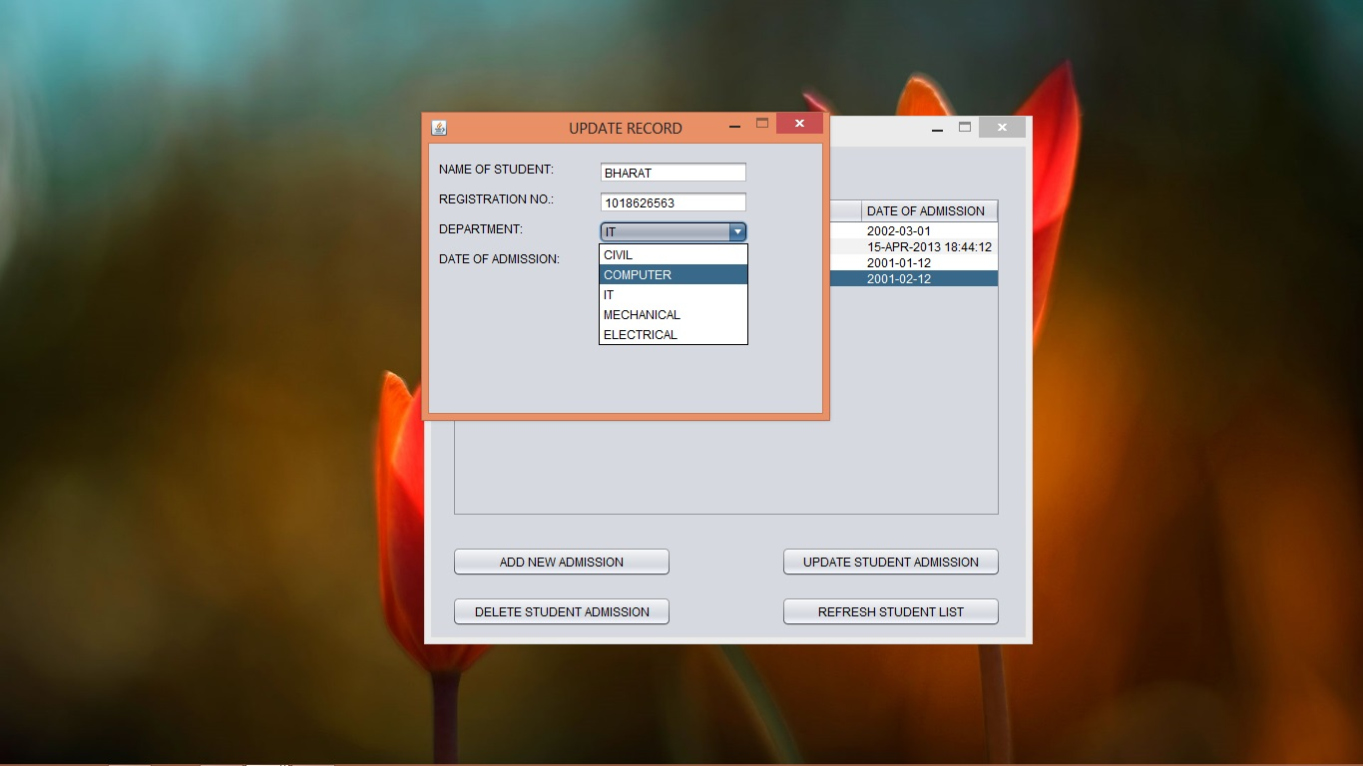

Slide 55
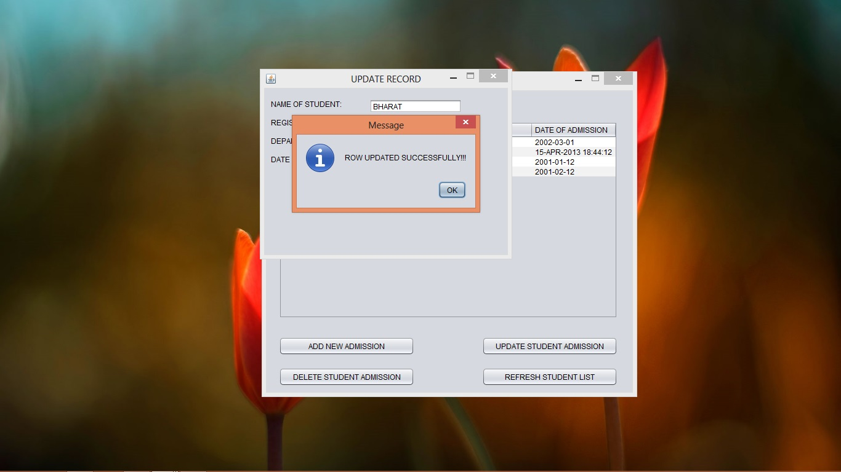

Slide 56
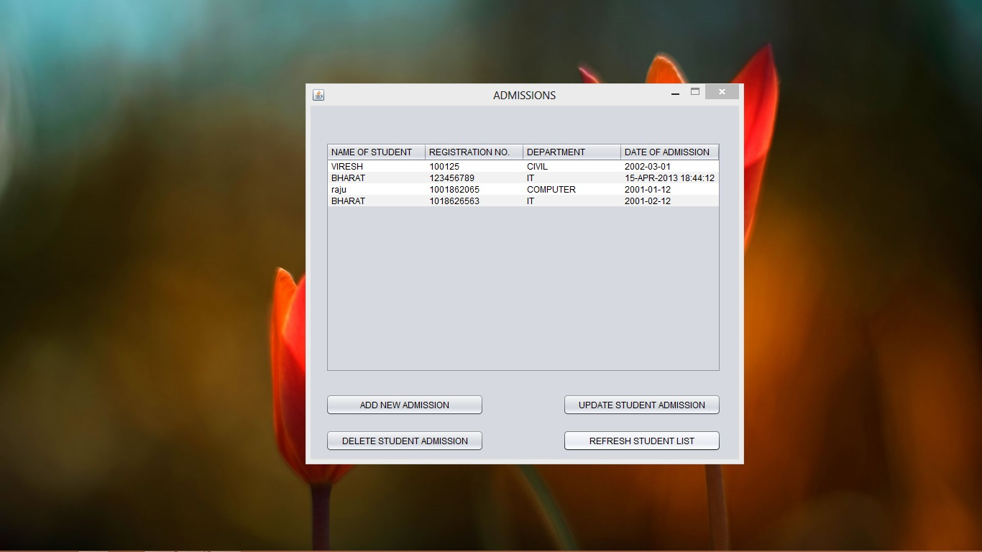

Slide 57
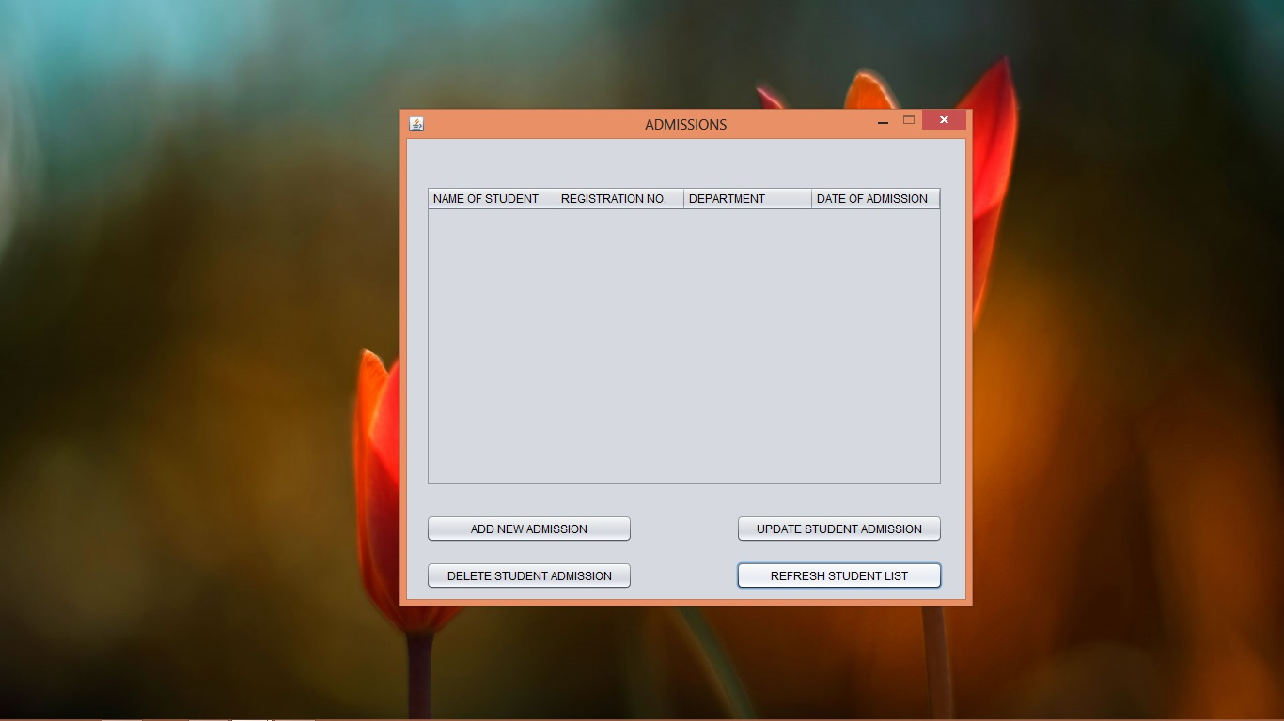

Slide 58
HOSTEL MANAGEMENT
SEARCH ROOM
ALLOCATE ROOM
DEALLOCATE ROOM

Slide 59
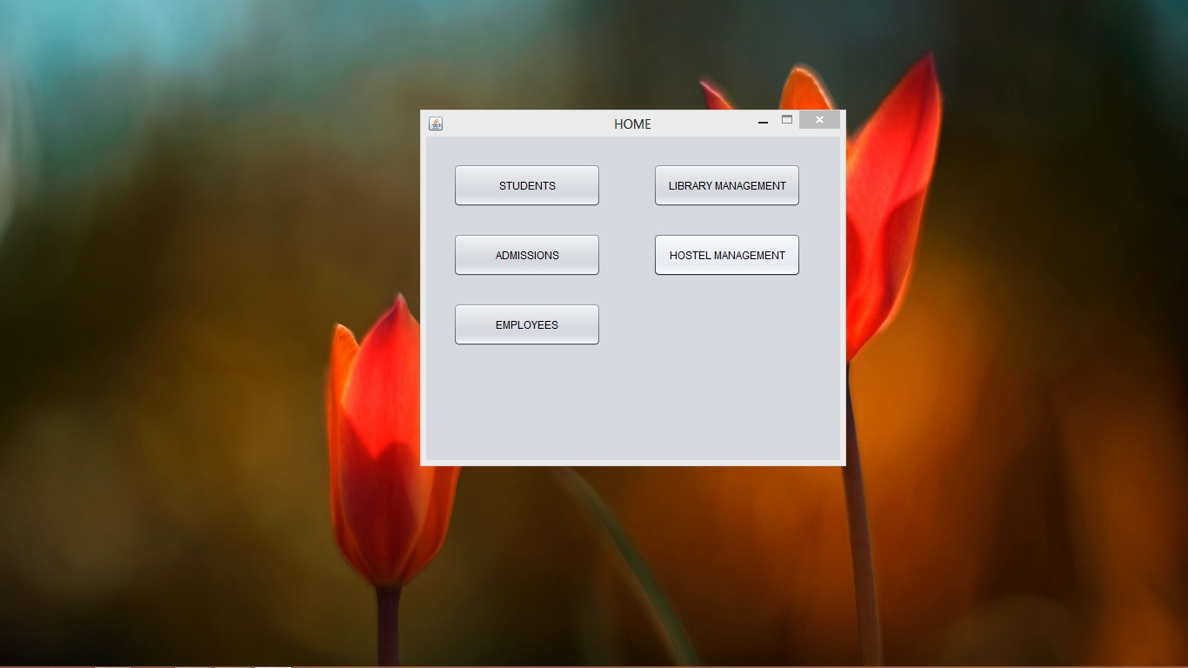

Slide 60
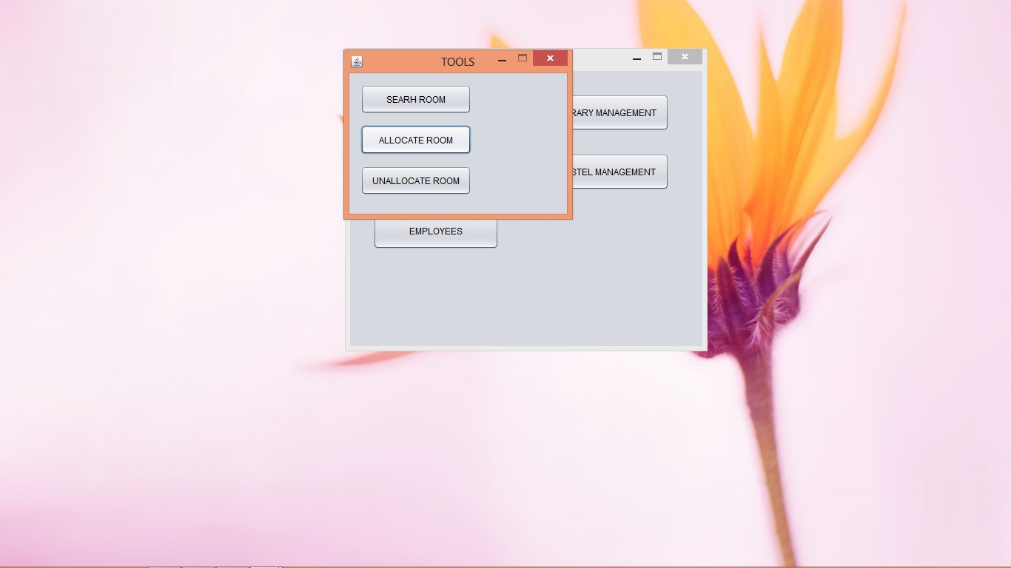

Slide 61
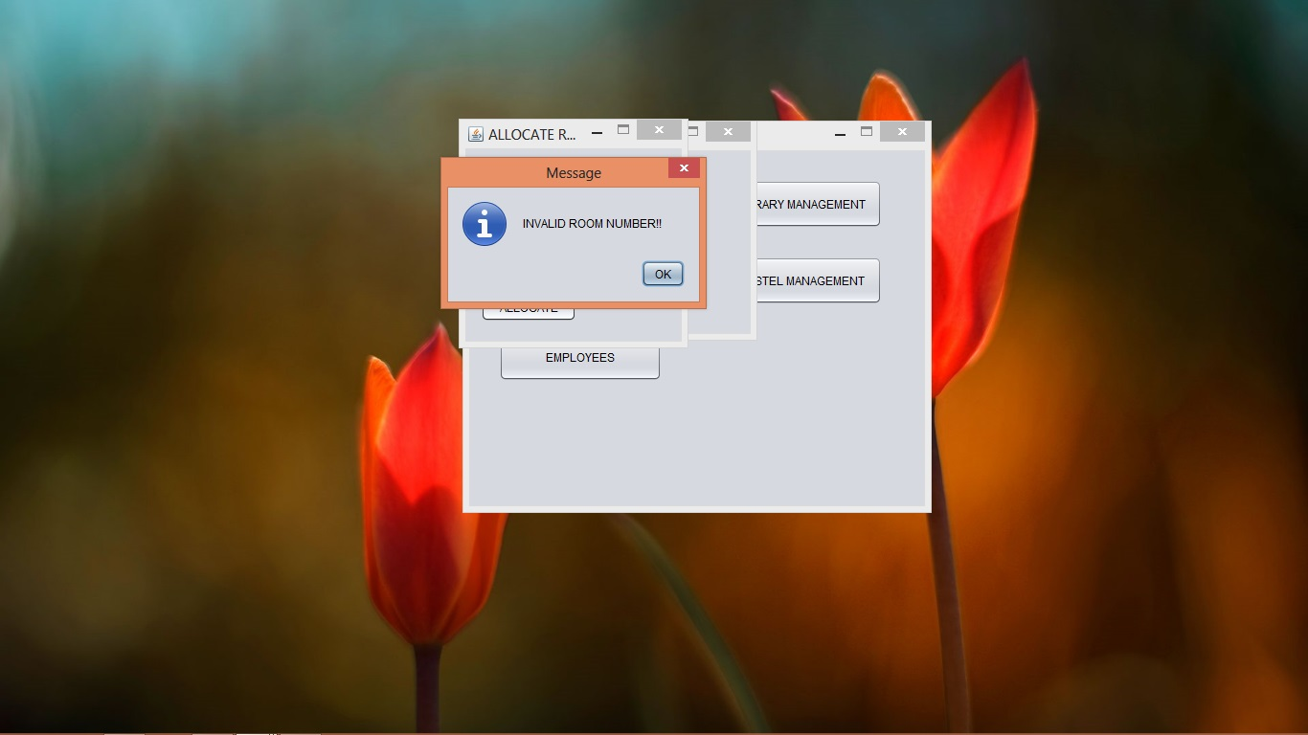

Slide 62


Slide 63
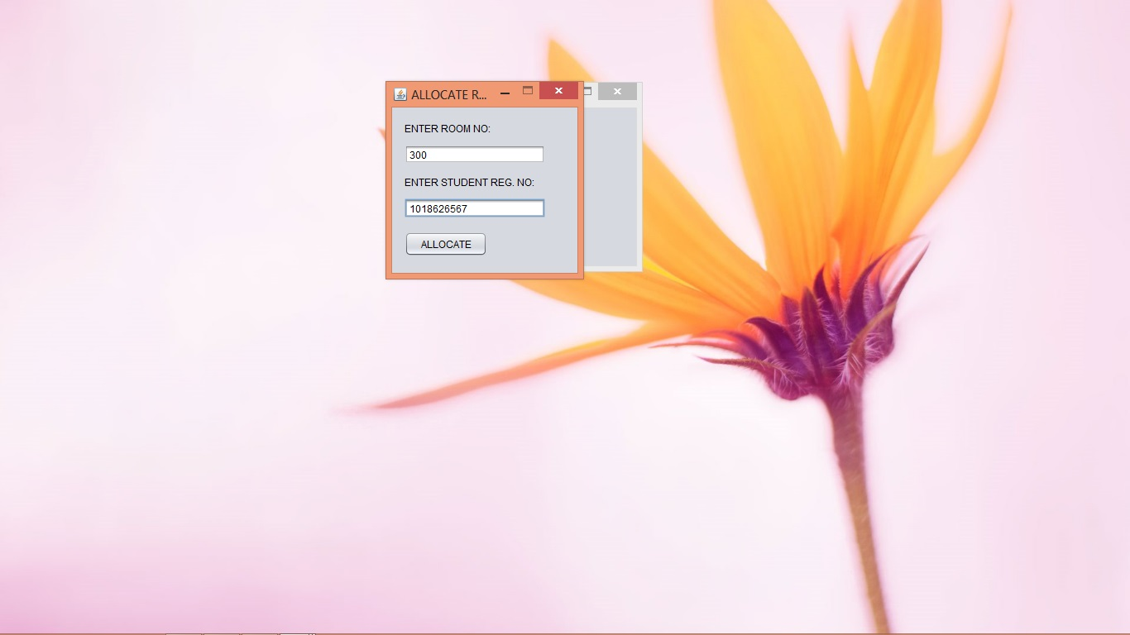

Slide 64
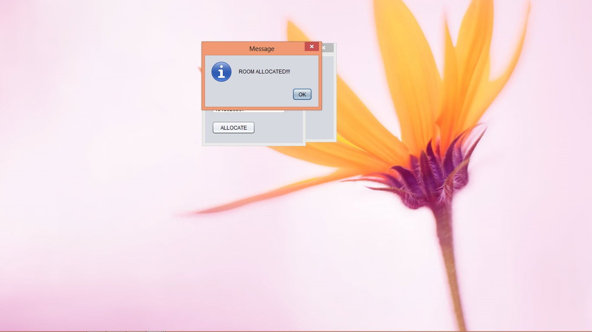

Slide 65
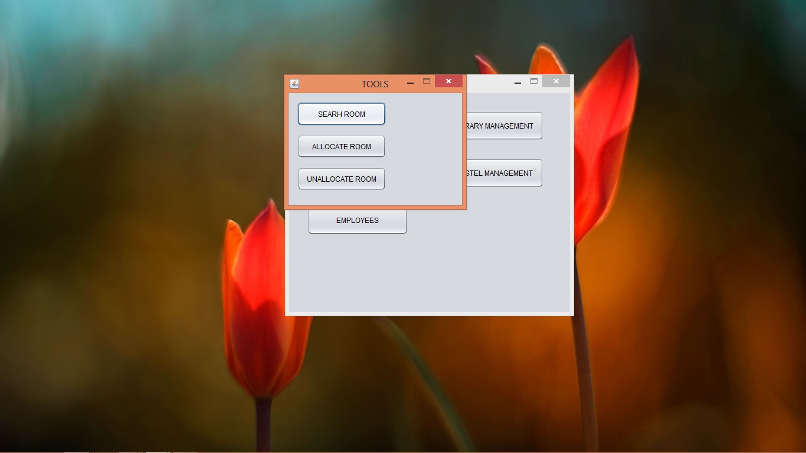

Slide 66
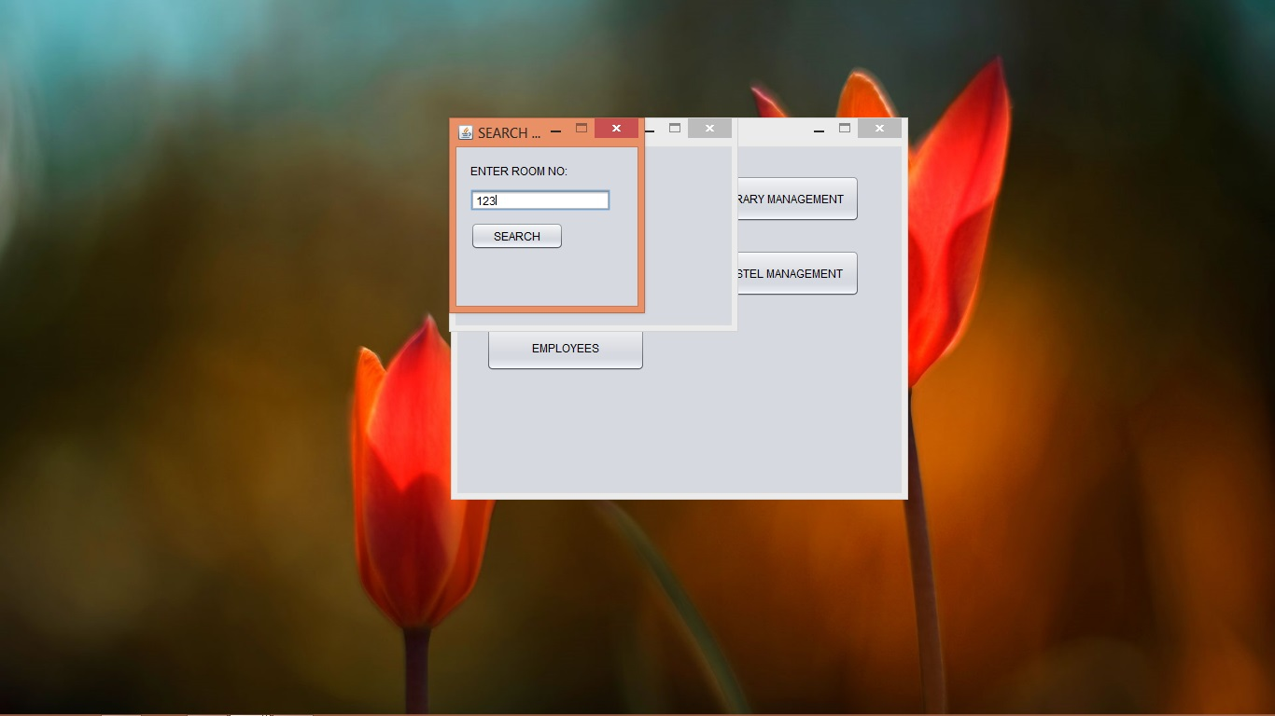

Slide 67
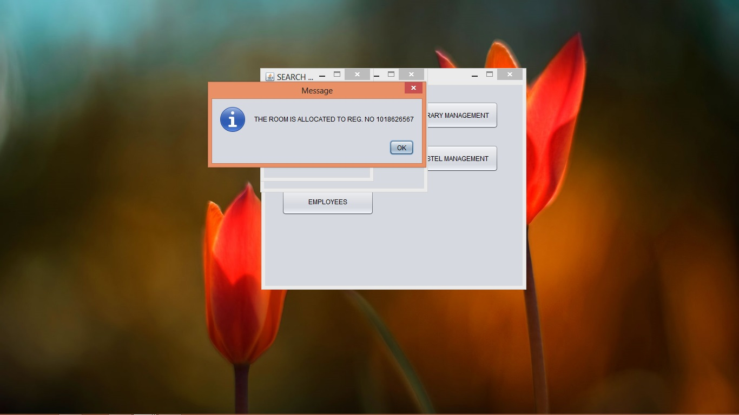

Slide 68
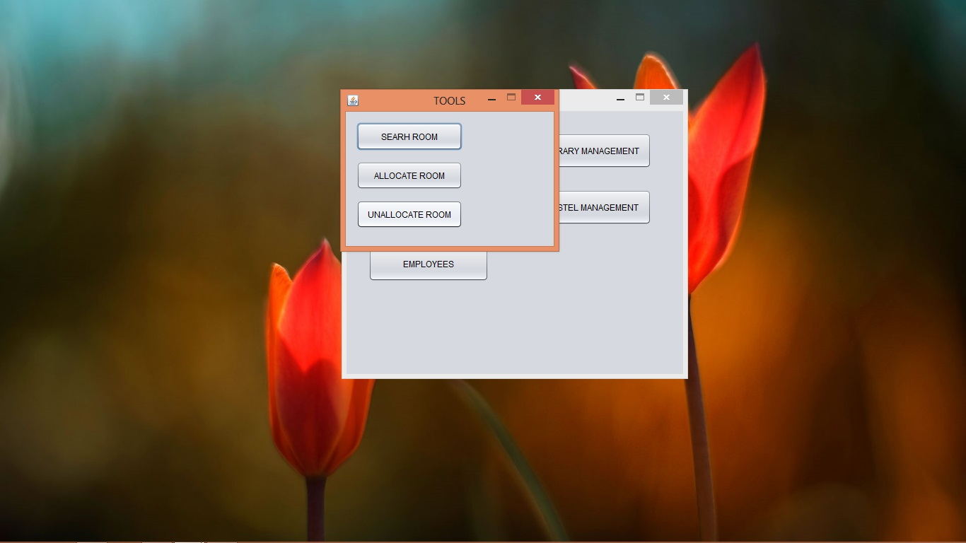

Slide 69


Slide 70


Slide 71
EMPLOYEES
ADD EMPLOY
DELETE EMPLOY
UPDATE EMPLOY
REFRESH EMPLOY LIST

Slide 72


Slide 73


Slide 74


Slide 75


Slide 76


Slide 77


Slide 78


Slide 79


Slide 80


Slide 81


Slide 82


Slide 83


Slide 84


Slide 85


Slide 86


Slide 87


Slide 88


Slide 89
DATABASE OF PROJECT

Slide 90


Slide 91


Slide 92


Slide 93


Slide 94


Slide 95


Slide 96
END OF PROJECT
THANKS

